Slide 1
Levels of Testing
Functional Testing
Integration Testing
Smoke Testing
Sanity Testing
System Testing
Regression Testing
Acceptance Testing

Slide 2
Functional Testing
FUNCTIONAL TESTING is a type of software testing whereby the system is tested against the functional requirements/specifications.
Functions (or features) are tested by feeding them input and examining the output. Functional testing ensures that the requirements are properly satisfied by the application. This type of testing is not concerned with how processing occurs, but rather, with the results of processing. It simulates actual system usage but does not make any system structure assumptions.

Slide 3

Functional testing involves the following steps:
Identify functions that the software is expected to perform.
Create input data based on the function’s specifications.
Determine the output based on the function’s specifications.
Execute the test case.
Compare the actual and expected outputs.

Slide 4
Levels of functional testing performed
Functional testing is normally performed during the levels of System Testing and Acceptance Testing.
SYSTEM TESTING is a level of software testing where a complete and integrated software is tested. The purpose of this test is to evaluate the system’s compliance with the specified requirements.
ACCEPTANCE TESTING is a level of software testing where a system is tested for acceptability. The purpose of this test is to evaluate the system’s compliance with the business requirements and assess whether it is acceptable for delivery.

Slide 5
Tasks performed in system testing
System Test Plan
Prepare
Review
Rework
Baseline
System Test Cases
Prepare
Review
Rework
Baseline
System Test
Perform

Slide 6
Perform system testing
When is it performed?
System Testing is the third level of software testing performed after Integration Testing and before Acceptance Testing.
Who performs it?
Normally, independent Testers perform System Testing.

Slide 7
Tasks performed in Acceptance testing
Acceptance Test Plan
Prepare
Review
Rework
Baseline
Acceptance Test Cases/Checklist
Prepare
Review
Rework
Baseline
Acceptance Test
Perform

Slide 8

When to perform and who to perform acceptance testing
When is it performed?
Acceptance Testing is the fourth and last level of software testing performed after System Testing and before making the system available for actual use.

Slide 9
Who performs it?
Internal Acceptance Testing (Also known as Alpha Testing) is performed by members of the organization that developed the software but who are not directly involved in the project (Development or Testing). Usually, it is the members of Product Management, Sales and/or Customer Support.
External Acceptance Testing is performed by people who are not employees of the organization that developed the software.
Customer Acceptance Testing is performed by the customers of the organization that developed the software. They are the ones who asked the organization to develop the software. [This is in the case of the software not being owned by the organization that developed it.]
User Acceptance Testing (Also known as Beta Testing) is performed by the end users of the software. They can be the customers themselves or the customers’ customers.

Slide 10
Smoke Testing
SMOKE TESTING, also known as “Build Verification Testing”, is a type of software testing that comprises of a non-exhaustive set of tests that aim at ensuring that the most important functions work. The result of this testing is used to decide if a build is stable enough to proceed with further testing.
The term ‘smoke testing’, it is said, came to software testing from a similar type of hardware testing, in which the device passed the test if it did not catch fire (or smoked) the first time it was turned on.

Slide 11
Advantages of smoke testing
It exposes integration issues.
It uncovers problems early.
It provides some level of confidence that changes to the software have not adversely affected major areas (the areas covered by smoke testing, of course)
Smoke testing is normally used in Integration Testing, System Testing and Acceptance Testing levels.

Slide 12
Regression Testing
REGRESSION TESTING is a type of software testing that intends to ensure that changes (enhancements or defect fixes) to the software have not adversely affected it.
The likelihood of any code change impacting functionalities that are not directly associated with the code is always there and it is essential that regression testing is conducted to make sure that fixing one thing has not broken another thing.
During regression testing, new test cases are not created but previously created test cases are re-executed.
Regression [noun] literally means the act of going back to a previous place or state; return or reversion.

Slide 13
Regression testing advantages
Regression testing is a type of software testing technique where the QA team runs a set of test cases to verify that with bug fixes or with the addition of new features in the application, the previous functionalities are not hampered. Here are some of the benefits of regression testing
It promotes the improvement of the product quality.
It ensures that the issues already detected, and fix are not creatable now.
It verifies that the modifications do not impact the correct work of already tested code – detects any side effects.
Regression tests can be used during integration testing. In this case, they will be more useful.

Slide 14
Types of regression testing
Full Regression: This Regression involves going through the entire application or website once again to make sure that all the functional areas are working as expected and none of the current functionalities is hampered. This can either be done manually or can be automated as well.
Partial Regression: This is done basically when a software tester wants to analyze the effects of a bug fix to other areas of that particular part of the application. This is done by running some selective test cases from the test suite, just to make sure that the recent changes have not impacted other functional and verified areas of the code.

Slide 15
Difference between smoke and sanity testing
What is Software Build?
What is Smoke Testing?
What is Sanity Testing?
How to conduct Smoke Testing and Sanity?
Smoke Testing vs Sanity Testing

Slide 16

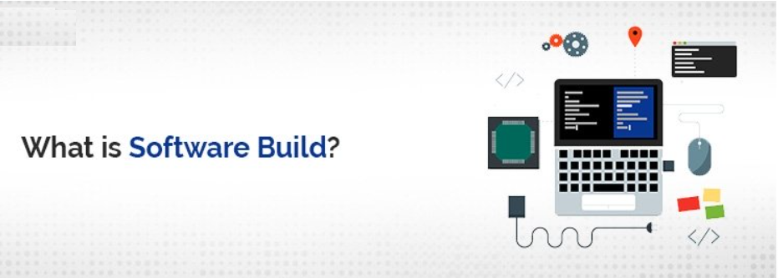
What is Software Build?
When you are developing a simple software program that consists of a few lines of source code, it is easy to compile and execute. But this is not the real situation in Companies.
A typical Software program or application usually consists of 100 or even 1000s of source code files. Creating an executable program from huge source code files is a quite complicated and time-consuming process too.
You need a build here to generate the executable program and this complete process is named as the “Software Build” in Software Engineering.

Slide 17

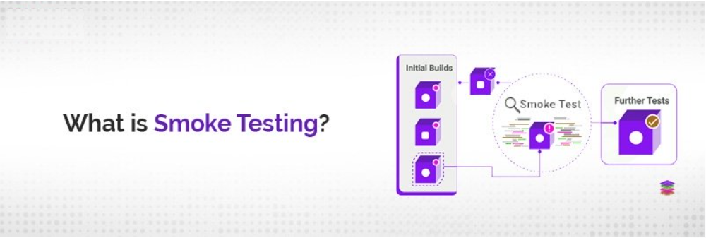
What is Smoke Testing?
Smoke Testing is a special type of testing performed on Software build to check the critical functionalities of the program. It is done at the early stage before regression testing or any other detailed testing is performed on the software build. The purpose of smoke testing is to reject badly performing applications so that the QA team does not have to waste time in the installation or testing of a software application.
In smoke testing, the test cases are chosen to define the most critical functions of the application or component of the system. The objective is clear here to verify the most critical functionalities of the system either they are working fine or not.
For example, a typical smoke test involves:
Verification of the application either it is launched successfully or not,
Verify either GUI of the application is responsive or not,
Verify either financial transactions are completed well and more

Slide 18

What is Sanity Testing?
Sanity Testing is a special type of software testing performed after receiving a software build with little changes in code or functionality to ascertain that certain bugs have been fixed in advance to resolve workflow issues. The goal of sanity testing is to determine that the proposed functionalities are working roughly as expected. If sanity testing fails then the build is rejected directly to save time and costs that are involved in more rigorous testing.
Sanity testing is performed during the release phase to check the main functionalities of an application without going into depth. It is named as the subset of regression testing. There are certain cases when regression testing is not done to the build due to time constraints and sanity testing is considered more suitable to check the main functionalities.

Slide 19


How to conduct Smoke and Sanity Testing?
To conduct the smoke testing, you have to write any test cases. You just have to pick the necessary test cases that are already written or defined by programmers. For Smoke Testing, our main objective is to focus on the application workflow. So, we can pick test cases from the test suite that cover major functionalities of the software program.
To conduct sanity testing, you don’t have to write any separate test cases similar to smoke testing. You just have to pick the necessary test cases that are already written by programmers. Testers just have to make sure that the planned functionality is working as needed.

Slide 20

Smoke vs Sanity
Smoke Testing | Sanity Testing
Smoke testing ascertains that core functionalities of the program are working fine absolutely. | Sanity Testing is done to check either new functionalities or bugs have been fixed properly without going deeper.
The objective of smoke testing is to verify the stability of the system to process regression testing in the future. | The objective of sanity testing is to verify the rationality of the system to proceed with more regression testing in the future.
Smoke testing is performed either by developers or testers. | Sanity testing is performed by testers only.
Smoke Testing is usually documented and scripted. | Sanity testing is not documented or scripted.
Smoke testing is a subset of acceptance testing. | Sanity testing is a subset of regression testing.
Smoke testing focuses on the entire system from end to end. | Sanity testing focused on selected components of a system.
Smoke Testing is like a General health check-up. | Sanity testing is like a special health check-up.

Slide 21
What is Reliability Testing?
Reliability is defined as the probability of failure-free software operation for a specified period of time in a particular environment.
Reliability testing is performed to ensure that the software is reliable, it satisfies the purpose for which it is made, for a specified amount of time in a given environment and is capable of rendering a fault-free operation
Example:
Consider the following situation in which we are testing a functionality, Say at 9:30 am and testing the same functionality at 1 pm again. Later, we compare both the results. We are getting a high correlation in the results. Then we can say that the test is ‘Reliable'.

